Slide 1
TEE Password Vault - in a Chrome Extension
בס"ד
By David Berger and Eyal Seckbach
At Lev Academic Institute | Instructor: Barak Einav | June 2022 (2nd Semester)

Slide 2
Overview
Motivation for the project
Implementation
Security Analysis
Future Ideas

Slide 3
1. Motivation
Weakest link – User made passwords are often weak
Tradeoff of Security and Usability

Slide 4
Password Vault – Software or Hardware?
Software
Hardware
Accessible from any machine (& portable)
More Easily Scalable
If something happens to the Hardware, the information is lost
often more secure; less bugs and backdoors, less attack surfaces
Implementation, management is much simpler

Slide 5
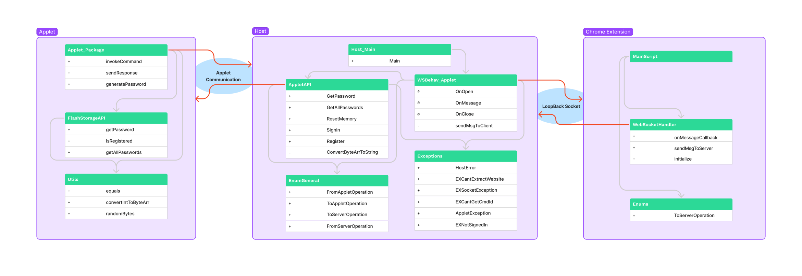
2. Implementation

Slide 6
Why Websockets?
Websocket
Regular Socket
Specific, Limited
Full Duplex Commmuncation
(Faster)
Generic, Versatile
Frequent Connection
Set-Up
(Slower)

Slide 7
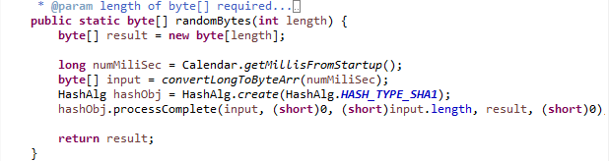
Generating the Random Password
Motivation for the project
Implementation
Security Analysis
Future Ideas

Slide 8
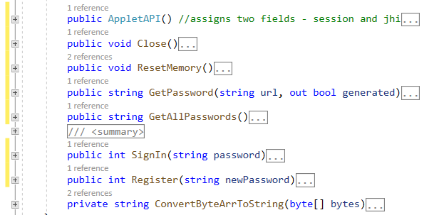
Organized API’s

Slide 9
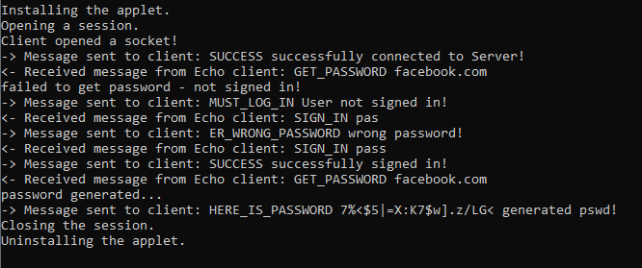
Server – Full Echo of Socket Commication

Slide 10
Chrome Extension - features
Requires Master Password (2 point Verification)
Pulls URL Programmatically (Chrome.ActiveTabs.Query)
Inserts Password Programmatically –
(Injects Script into Chrome Browser)
Versatile – Can be run without Chrome (checkbox)

Slide 11
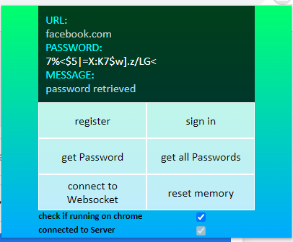
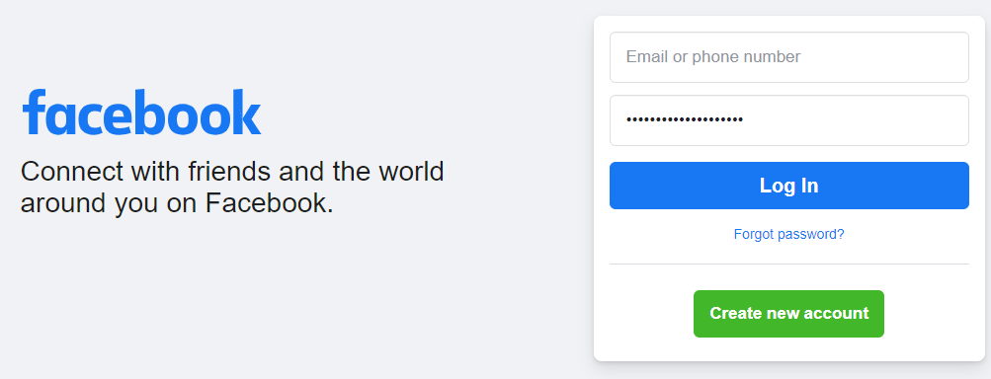
Time for the Demo!!

Slide 12
3. Security Analysis
Assets
Attack Surfaces
Response to Breach

Slide 13
Assets
Passwords in the Vault
→ Protected by TEE structure and 2point Verif.
Algorithm to Generate the Passwords
→ No Security Thru Obscurity – use Hash1
→ Randomize Seed

Slide 14
Attack Surfaces
User Input – no protection in our current product, although
(Although easy to protect -> there is little input)
Sniffing – Runs over LocalHost (127.0.0.0).
(If he can see LocalHost, we have bigger issues…)
Hardware Breach
"Intel Trusted Execution Technology provides hardware-based mechanisms that help protect against software-based attacks and protects the confidentiality and integrity of data stored or created on the client PC.“ – Intel’s Website

Slide 15
Response to Breach
User should use “Get All Passwords”, and immediately reset password for each website
(The Attacker would be immediately stopped)
We would analyze the specific attack (ledger) before recommending the User to continue using our product

Slide 16
4. Future Ideas
A better random seed (ex physical world generated instead of time...)
Enabling Multiple users (on one computer) to use the TEE
Allowing User to hide the Console’s Echo
Storing both the password and username with the URL
Running a background script, offering User to save password in the Vault whenever User enters a password on a website
Encrypting or Signing (or both) communication (Host <-> Applet, and Host <-> Chrome Extension)

Slide 17
Thanks for Listening!
☺ ☺ ☺

